Slide 1
What is .NET?
An Overview of the Platform

Slide 2
Overview OF .NET?
Microsoft's ambition to provide developers with one platform to solve any type of problem has been fulfilled by .NET. For a couple of decades already, the .NET platform has been powering up web, desktop, and mobile ap
Without any doubt, .NET plays a central role in the software development industry. .NET popularity in the developer community is a fact. You can measure it through the number of open source projects around the world and the presence of C# among the five most popular programming languages. Its popularity is going to grow even more, especially after the latest release (.NET 5), which revolutionizes the industry by pioneering the concept of universal software development.plications in both the startup and enterprise scenes.

Slide 3
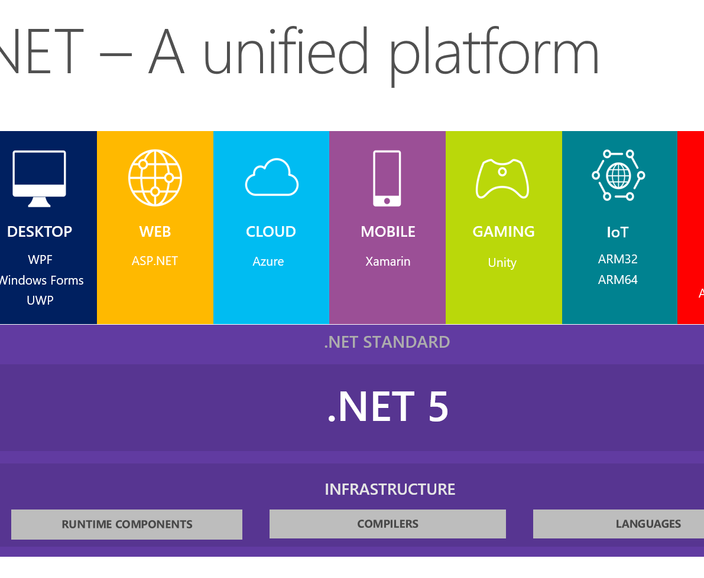
What Is .NET ?
.NET is an open-source and cross-platform development platform for building many types of applications. Designed by Microsoft, the platform supports multiple programming(62+) languages and libraries to build web, mobile, desktop, IoT applications, and more.

Slide 4
Some Important Languages Mentioned !
Even if C# is considered the main programming language for .NET, you can use many other different languages of your choice. The languages directly supported by Microsoft are:
C# (C sharp): A modern object-oriented programming language that belongs to the C language family. Its syntax may look familiar to C, C++, Java, and JavaScript developers. It supports Multilanguage
.NET supports the Common Language Infrastructure (CLI), so your source code is compiled into a Common Intermediate Language (CIL), independently of the programming language you use. This guarantees great interoperability between languages in the platform.
Besides the above mentioned languages supported directly by Microsoft, many other programming languages can compile to the .NET CIL. For example, ClojureCLR, Eiffel, IronPython, PowerBuilder, and many others. For a complete list, check out this page.

Slide 5

.NET Architecture and Components
.NET allows you to build different application types, ranging from command-line to desktop applications, from web to mobile applications, from gaming to IoT applications.
This all Is Just Possible Because Of Its Modular Support And Optimize Architecture .
.NET Components
The .NET architecture is based on two main components:
CoreCLR: This ( Common Language Infrastructure )is the .NET runtime. It is responsible for executing CLI (Common Intermiediate language )programs and includes a just-in-time compiler.
CoreFX: The platform’s API implementing the CLI Standard Libraries, that is, the set of libraries that provide the most common functionalities, such as file system management, exception handling, network communication, threading, reflection, and so on. The CoreFX component is sometimes called the Unified Base Class Library.

Slide 6
.NET Application Models ?
Above the core components, you have the different application model frameworks, that is, the libraries that offer support for developing different types of applications. So, for example, you have:
ASP.NET: The framework that allows you to build web applications and web APIs.
Windows Presentation Foundation (WPF): A graphical user interface for Windows desktop applications.
Xamarin: The framework for building cross-platform mobile, TV, and desktop applications.
Blazor: The framework to build client web applications by using C#. It also allows you to generate client web apps in WebAssembly code.
ML.NET: The machine learning framework that simplifies the integration of machine learning models in your .NET application.
For any other needs not embedded in the framework, you can find a huge number of specific libraries on the public NuGet repository. In fact, NuGet is the package manager for .NET. It allows you to create, share, and use many .NET libraries for almost any purpose.

Slide 7
.NET Design and Development Support
.NET support for software development is not limited to the multiple programming languages you can use. .NET also promotes the use of some best practices while letting you use the approach you prefer to build your application.
For example, it encourages you to use dependency injection to decouple your application’s components. Dependency injection helps you design better software by limiting the component interdependence and facilitating reuse. In addition, it makes it easier to test your components.
By the way, on the testing side, .NET also comes with support for unit and integration tests via xUnit.
On the front of the development experience, developers can choose from different approaches. They can use the .NET CLI environment, using the command line to create new projects, adding dependencies, build, run, and so on.
They can use Visual Studio Code for an intermediate approach: an advanced cross-platform editor on top of the .NET CLI. Or they can use a powerful IDE like Visual Studio, available for both Windows and Mac, that provides you an interactive programming experience.

